Slide 1


Node.js for web developers

Slide 2
Please install Node.js
And download the code
https://nodejs.org
https://github.com/liron-navon/fresh-friday-node-intro
OR
https://bit.ly/2GlIioc

Slide 3

What is Node.js?
Node.js is an open-source, cross-platform asynchronous JavaScript run-time environment that executes JavaScript code outside of a browser.

Slide 4




Difference between Node.js and the browser:
Node is built with the ECMAScript standards, on top of V8 which is used to parse Chrome’s javascript code. This means it is mostly compatible with the code we run in the browser. But there are some things that are very different, lets play a game:
Browser OR Javascript

Slide 5
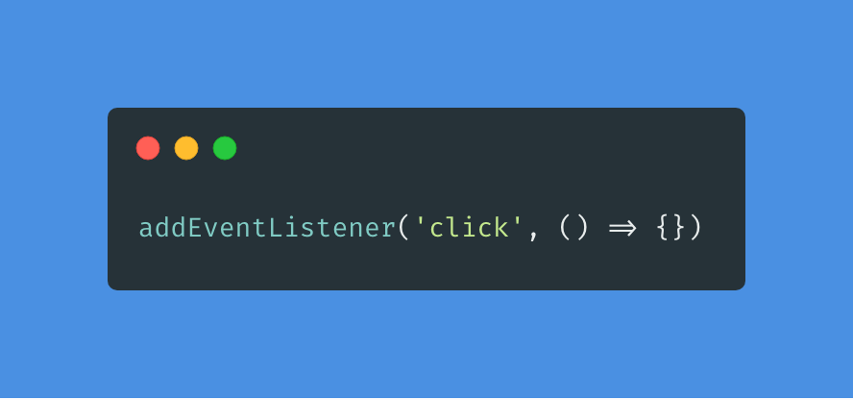
Browser OR Javascript

Slide 6
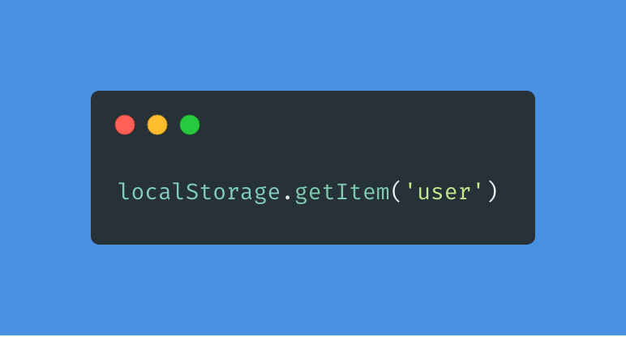
Browser OR Javascript

Slide 7
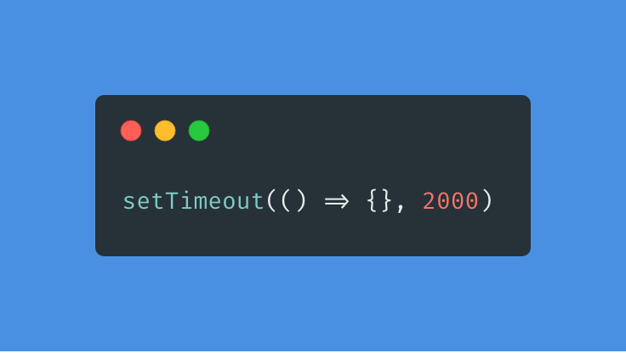
Browser OR Javascript

Slide 8
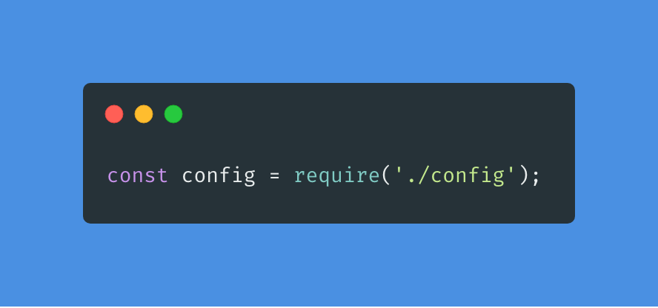
Browser OR Javascript

Slide 9


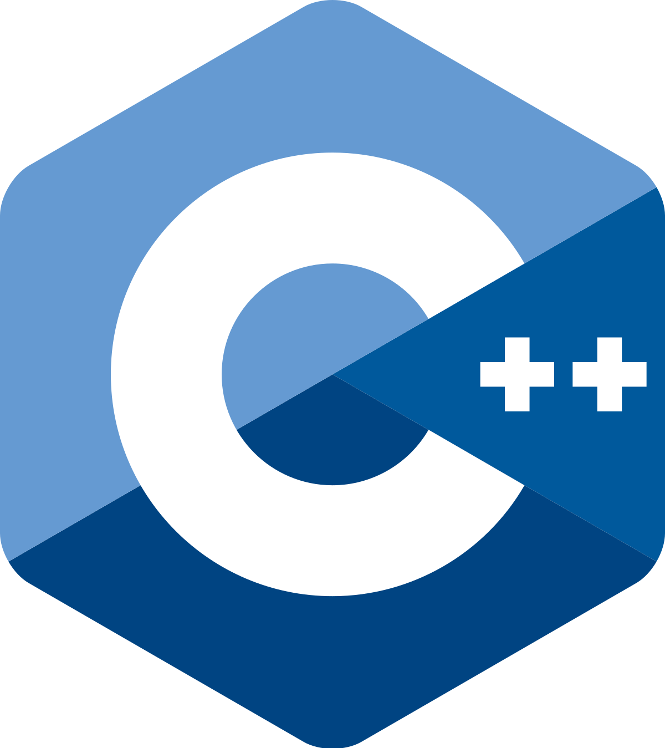


Slide 10
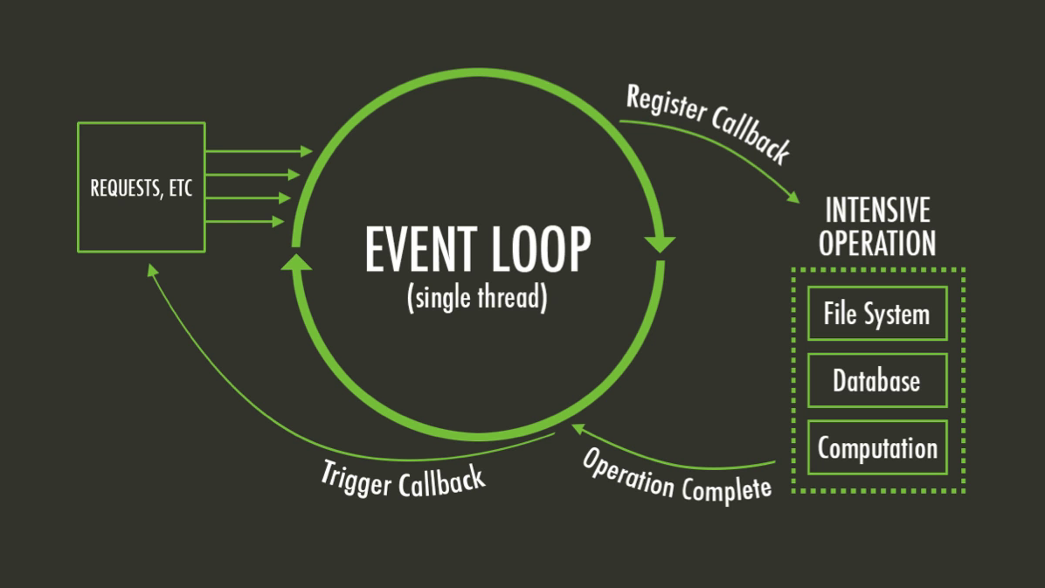

Slide 11
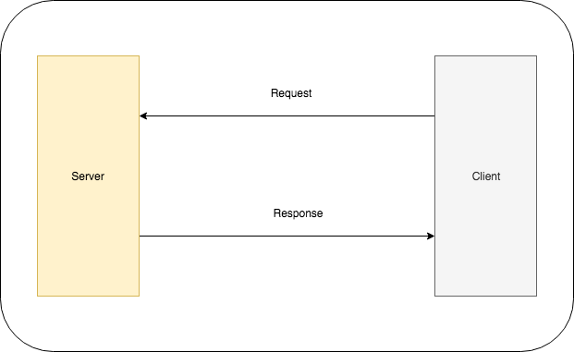
HTTP server

Slide 12
REST
Method | Path
GET | /order | Get all the orders
GET | /order/123 | Get a single order by id
POST | /order | Create a new order
PUT | /order/123 | Update an order by it’s id
DELETE | /order/123 | Delete an order by it’s id

Slide 13
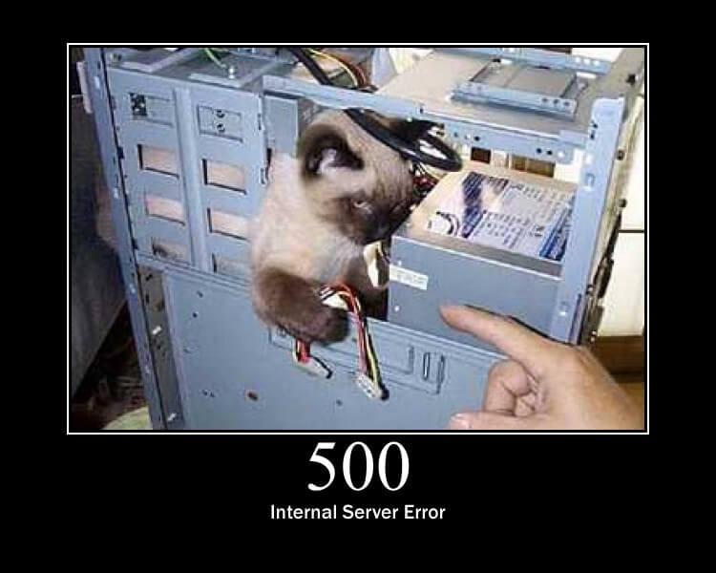
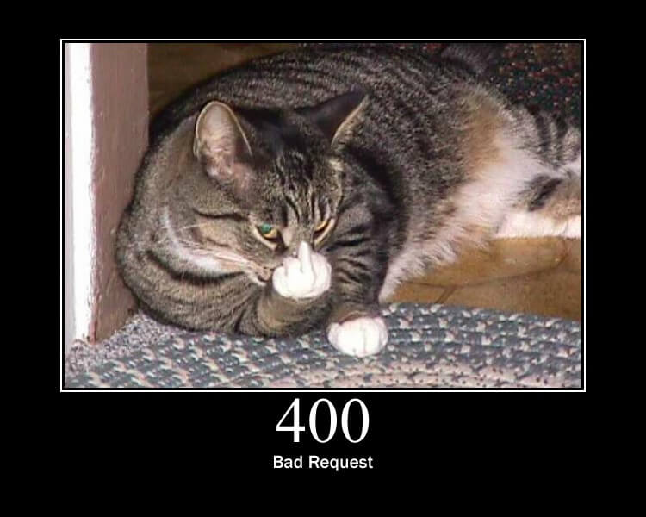
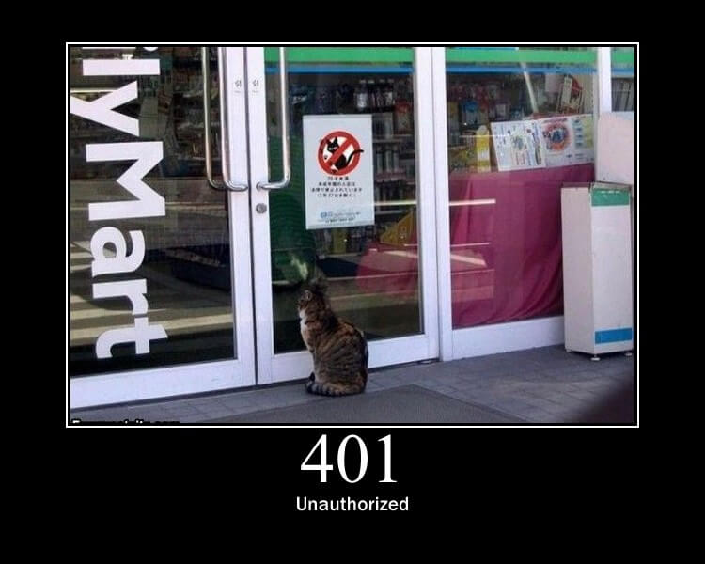
HTTP codes
HTTP servers use HTTP codes to be more descriptive and improve readability for responses.
Http cats

Slide 14
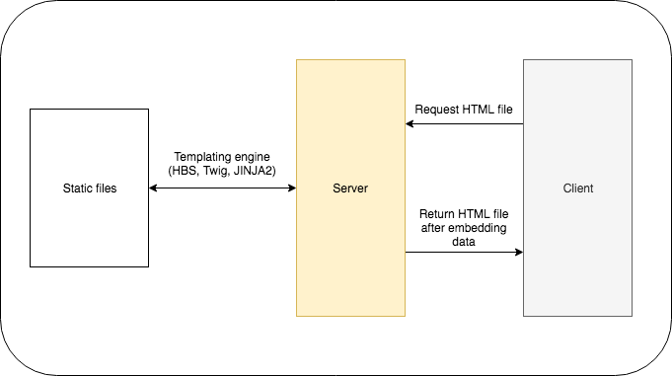
Templates

Slide 15
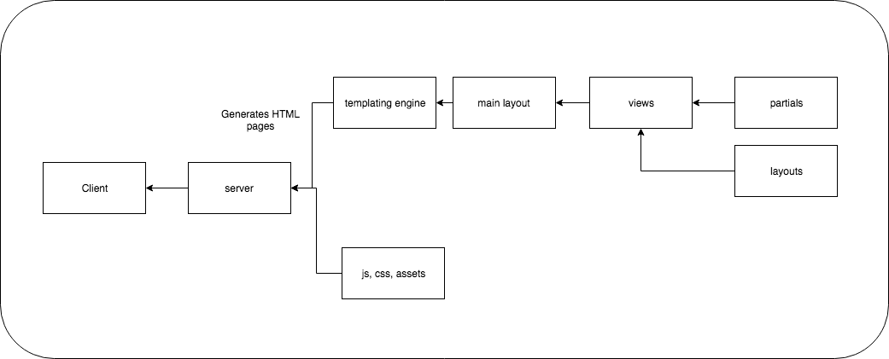
Template engines pipeline

Slide 16
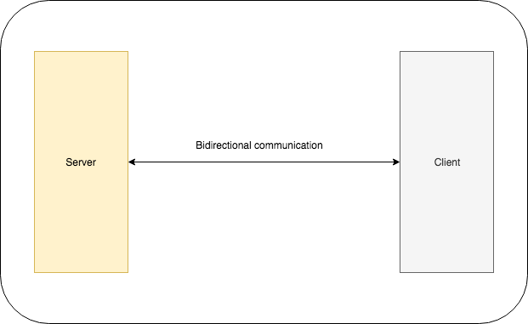
Websockets server

Slide 17
Let’s chat!
You can checkout the live message board here: https://enigmatic-ravine-98577.herokuapp.com/
OR
https://bit.ly/2N4ExUJ

Slide 18
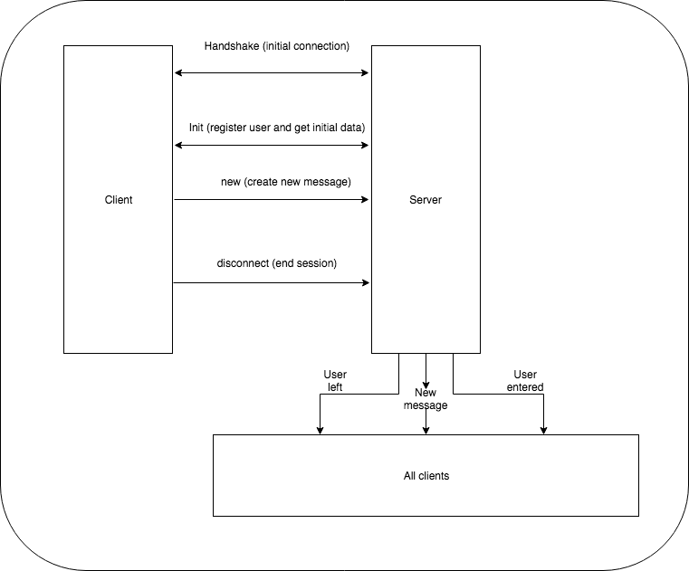
Our chat server

